Slide 1

NYC parking ticket analysis Introduction to BIG Data Final Project
Presented by:
RaghuRam Bobba(1322035)
Nithin Rao Dugyala(1324718)
G Harika(1325451)
Tejaswi Reddy (1325450)

Slide 2
Overview:
INTRODUCTION
DATA COLLECTION
DATA WAREHOUSE , DATA LAKE
AWS,EMR
DATA PIPELINING
DATA AND CODE ANALYSIS
OUTPUT

Slide 3
Introduction:
The project aims to analyze raw data from the 2017 NYC parking dataset, perform diverse aggregations, and present a range of statistics derived from the processed data.
Our study produced key findings, including the total number of violations categorized by state, the aggregate count of violations issued each day along with their respective descriptions, and the distribution of violations based on the types of vehicle bodies.

Slide 4
WHY CLOUD COMPUTING?
Amazon Web Services (AWS) is a leading cloud computing platform that offers a wide range of services to help organizations build and deploy applications, manage infrastructure, and access various computing resources.
Key components and services within AWS include:
Compute Services
Data base Services
Storage Services
Analytics Services

Slide 5
Data warehouse vs data lake
A data warehouse and a data lake are both storage architectures designed for handling and analyzing large volumes of data,
In our Project, we used Data Ware house, as it specially designed for structured data, it also ensures data consistency , accuracy along with that it helps in performing complex queries and analysis on aggregated data.

Slide 6
DATA COLLECTION
file name: NYC_Parking_data_2017.csv
Ref: https://www.kaggle.com/datasets/new-york-city/nyc-parking-tickets/data
The data set for the year 2017..
The size is 2.00GB
1048576 observations

Slide 7



Data Pipelining
Data Analysis
Data Source
NYC Parking Data
(Kaggle)
Data Ingestion
S3
EMR Cluster
Analytics

Slide 8
PROCESS
Create an AWS account as root user.
Create a s3 bucket (simple storage service).
Create an EMR cluster and run the spark job.(1 primary node and 5 core nodes).
Connect to Remote Host.
Used aggregate functions (respective applications ex: Spark, hive) to analyze the data.

Slide 9
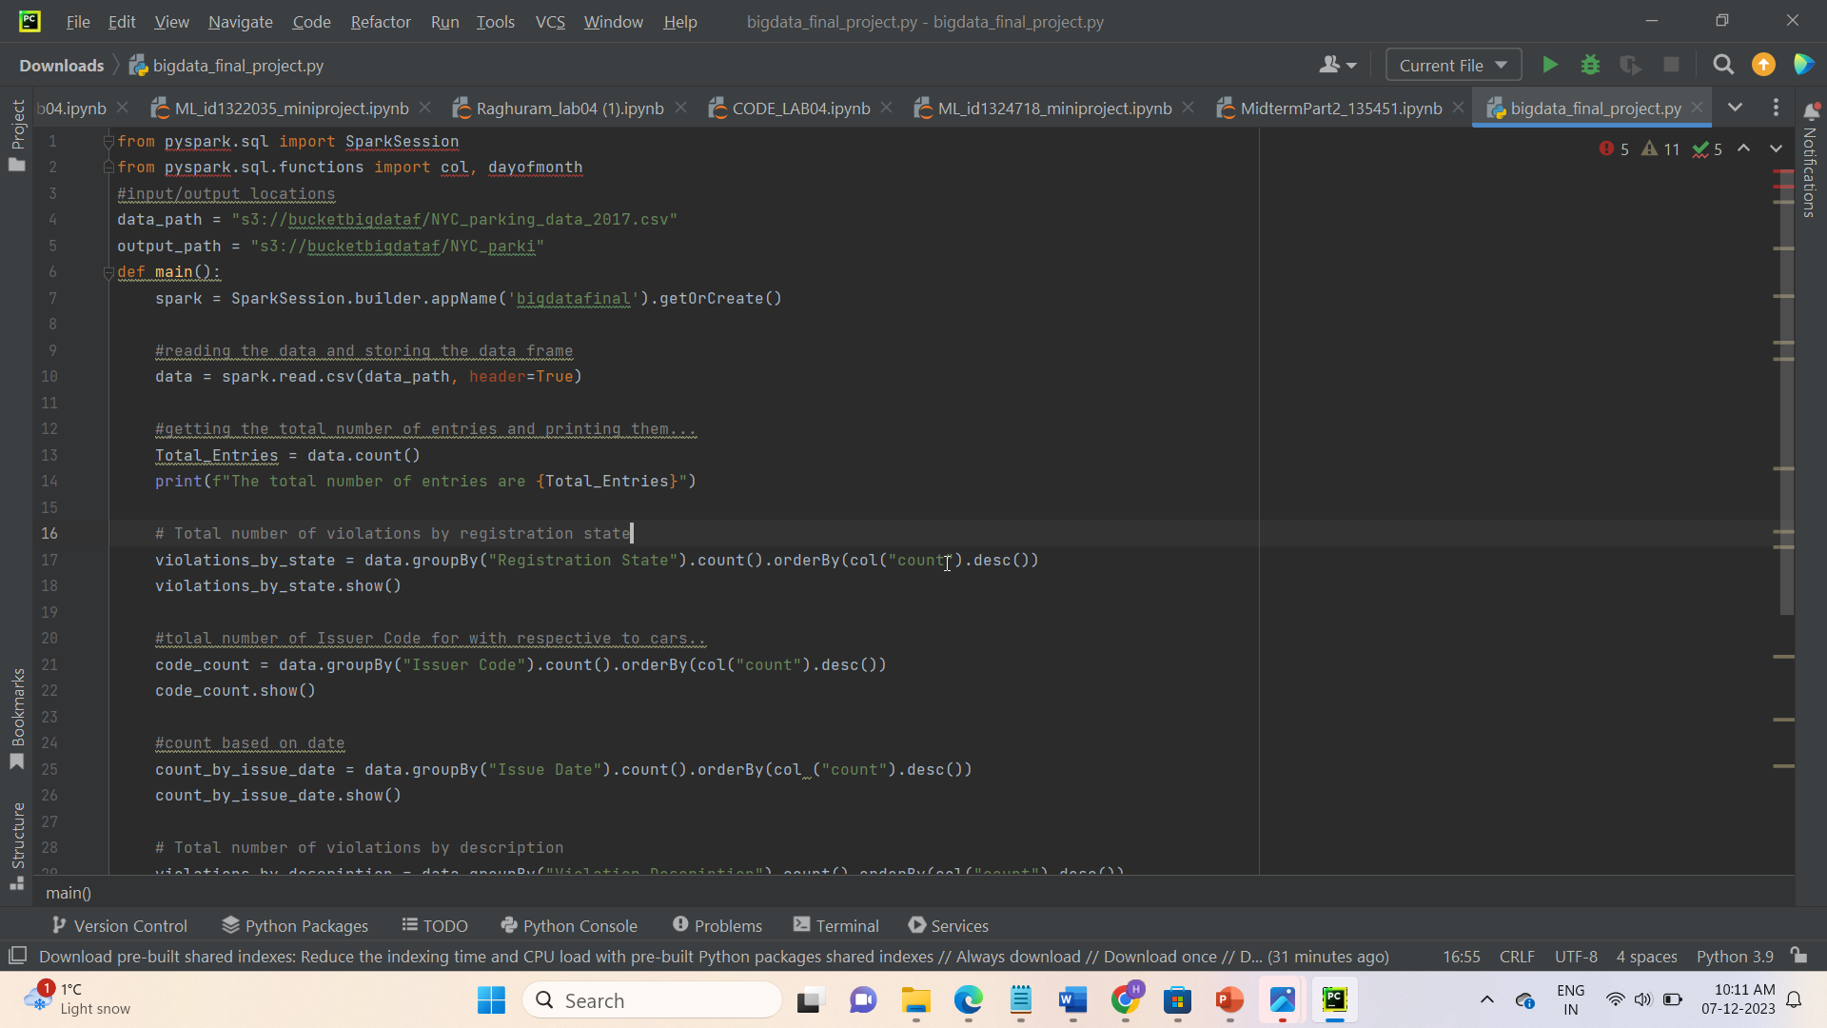
SNAP SHOT (i)

Slide 10
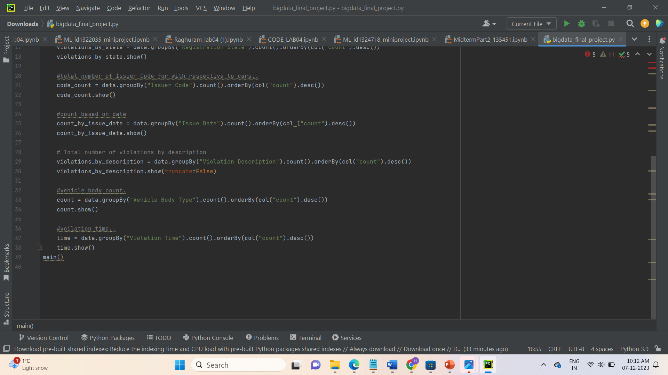
SNAP SHOT (II)

Slide 11
STEPS TO Connect emr

Slide 12
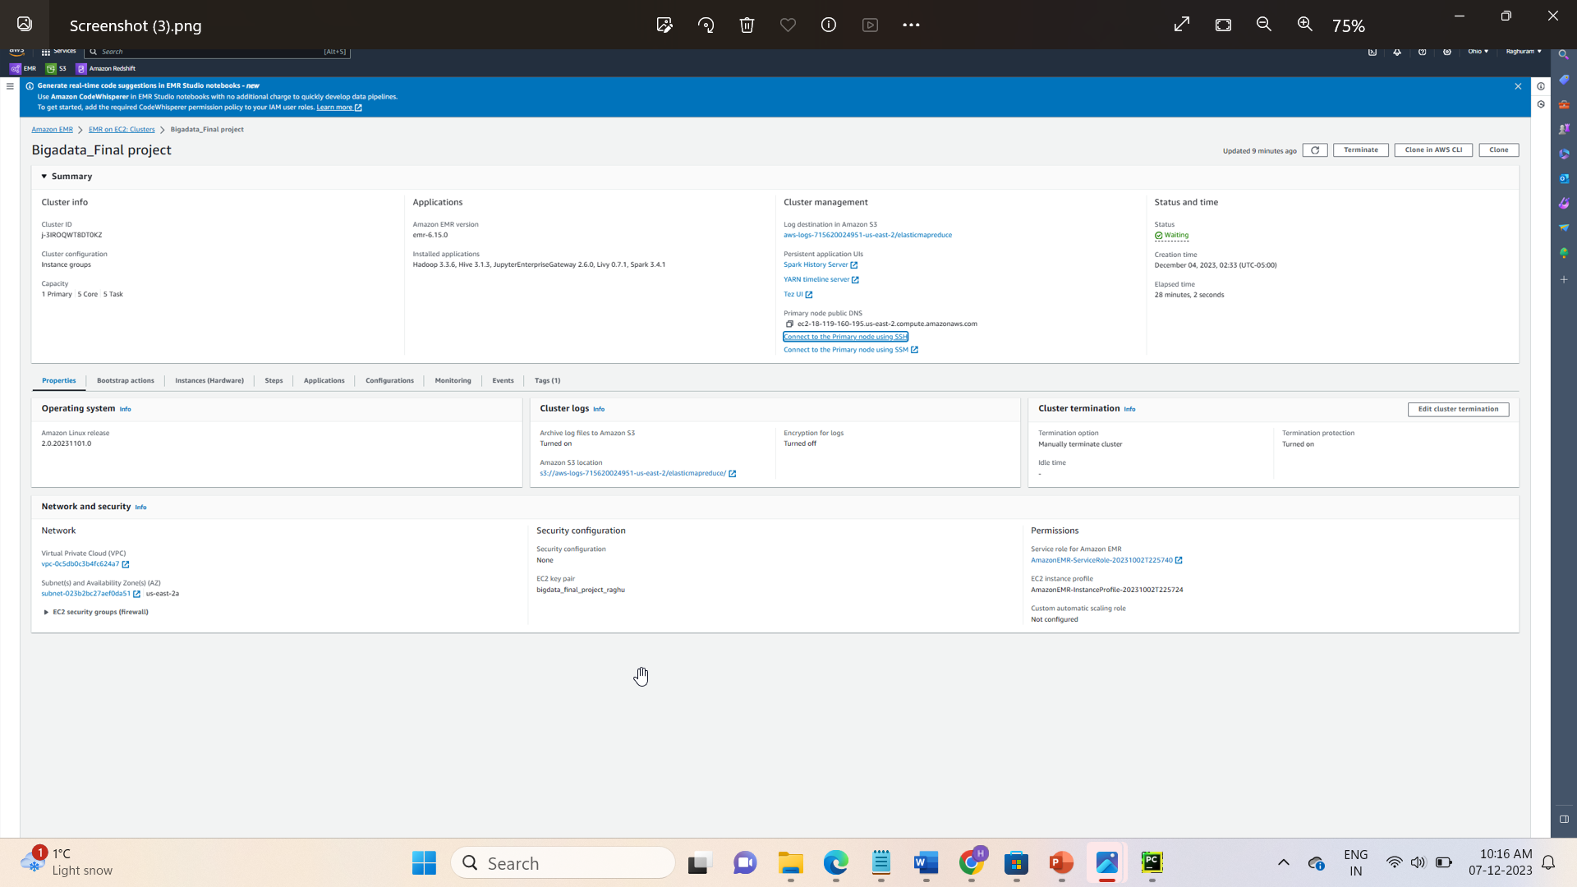

Slide 13
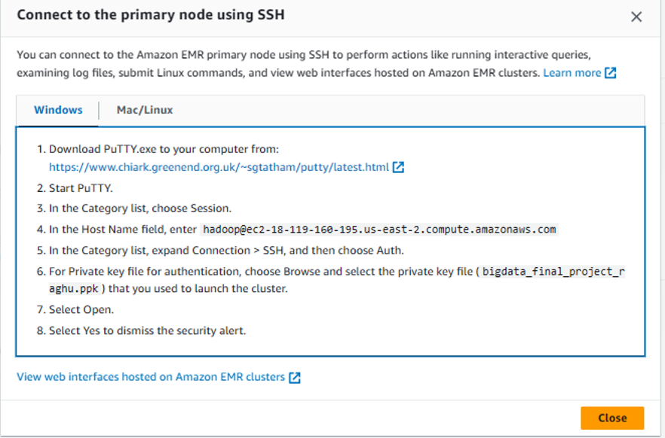

Slide 14


Slide 15
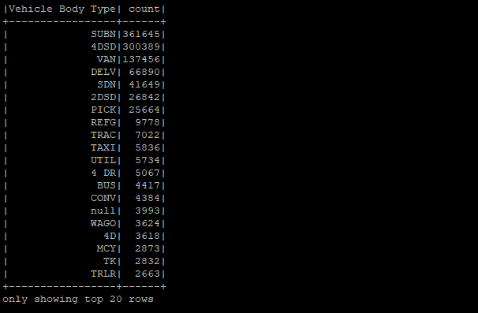
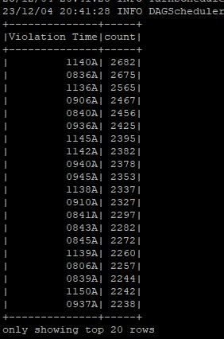
SAMPLE OUTPUT 1
SAMPLE OUTPUT 2

Slide 16
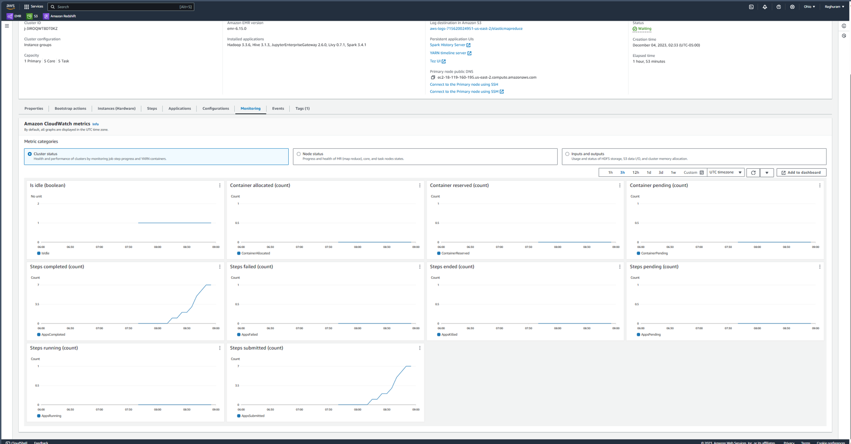
OBSERVATIONS
Hardware observations

Slide 17
References
LAB 03 ASSIGNMENT
AWS DOCUMENTATIONS
GEEKSFORGEEKS

Slide 18

ANY QUESTIONS?

Slide 19
Thankyou

